Slide 1
Superstore Project
Analysis And Sales Forecasting

Slide 2

Agenda
1.Overview
2.Data Understanding
3.Data Exploration& Cleaning
4.Asking Questions
5.EDA
6.Data Preprocessing
7.Model Evaluation
Analysis And Sales Forecasting

Slide 3


1.Overview
Analysis And Sales Forecasting

Slide 4
1.Overview
The Superstore Sales Analysis and Prediction project aims to analyze sales data from a fictional superstore and build predictive models to forecast future sales. This project utilizes Python libraries for data analysis and visualization, such as Pandas, Matplotlib, and Seaborn, along with machine learning models from Scikit-learn.
Analysis And Sales Forecasting

Slide 5

2.Data Understanding
Analysis And Sales Forecasting

Slide 6
2.Data Understanding
- ROW ID => Unique ID for each row
- Order ID => Unique Order ID for each Custome
- Order Date => Order Date of the product
- Ship Date => Shipping Date of the Product
- Ship Mode => Shipping Mode specified by the Customer.
- Customer ID => Unique ID to identify each customer
- Customer Name => Name of the Customer
- Segement => The segment where the Customer belongs
- Country => Country of residence of the Customer
- City => City of residence of the Customer
- State => State of residence of the customer
- Postal Code => Postal Code of every Customer
- Region => Region where the Customer belong
- Product ID => Unique of the product
- Category => Category of the product ordered
- Sub-Category => Sub-Category of the product ordered
- Product Name => Name of the Product
- Sales => Sales of the Product
Analysis And Sales Forecasting

Slide 7

3.Data Cleaning
Analysis And Sales Forecasting

Slide 8
3.Data Exploration& Cleaning
Data Exploration
df.head()
it shows the top five rows, allowing you to quickly inspect the structure
and content of your dataset
Data Cleaning
df.isnull().sum()
check for any null values in the data , and count the cull values
df.dropna(subset=[’Postal Code’])
df.info()
remove the null values in the column by rows , it will remove the row
that contains any null values
provide a concise summary of the DataFrame’s structure and content
df.duplicted().sum()
check for any duplicated values
Analysis And Sales Forecasting

Slide 9

4.Asking Questions
Analysis And Sales Forecasting

Slide 10
4.Asking Questions
1.what is the top 5 Selling Products
2.What is the Averge Sales by Region For Canon product
3.What ist the Average Sales by Region fo KI product
4.Which region generate the most sales ?
5.which state generate the most sales
6.What is the top 5 Cities by Sales
7.What is the averge Sales by product Category
8.which subCategory has the most Sales
9.What is the total Sales by cutomer Segment
10.Which segment generates the highest sales across different shipping modes?
11.What shipping mode sold the most products ?
12. What is the Sales Trend over time ?
13.what is the distribution of Shipping Duration
14.Is shipping Duration affect my Sales
15.What is the Reason of the Delaying of Shipping Duration?
16.What is the Average shipping duration by shipping Mode ?
17.what is the Average shipping duration by state ?
18.What is the Averge shipping Duration Over Time (Standard Class) ?
19.Average Shipping Duration by Product Category, State, and by Holidays?
20.What is the Averge Shipping Duration vs. Total Sales by State ?
Analysis And Sales Forecasting

Slide 11
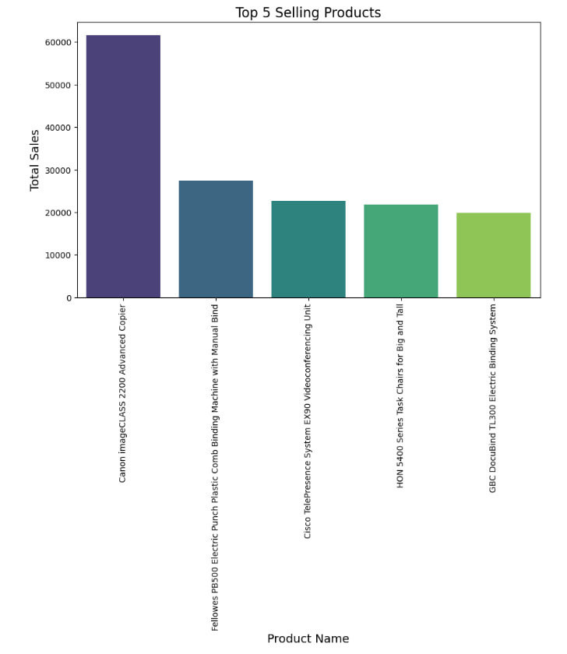
1.what is the top 5 Selling Products
Canon imageCLASS 2200 Advanced Copier 61599.824
Fellowes PB500 Electric Punch Plastic Comb Binding Machine with Manual Bind 27453.384
Cisco TelePresence System EX90 Videoconferencing Unit 22638.480
HON 5400 Series Task Chairs for Big and Tall 21870.576
GBC DocuBind TL300 Electric Binding System 19823.479
Name: Sales, dtype: float64

Slide 12
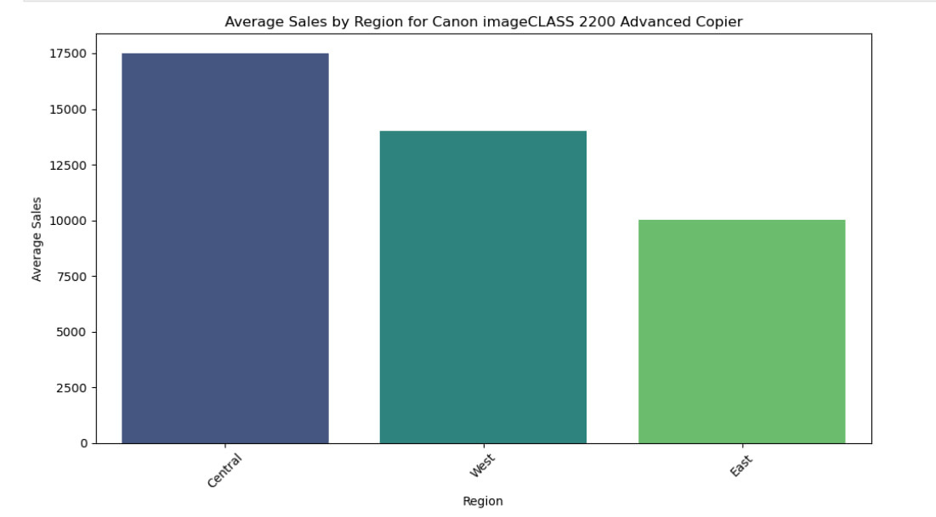

Slide 13
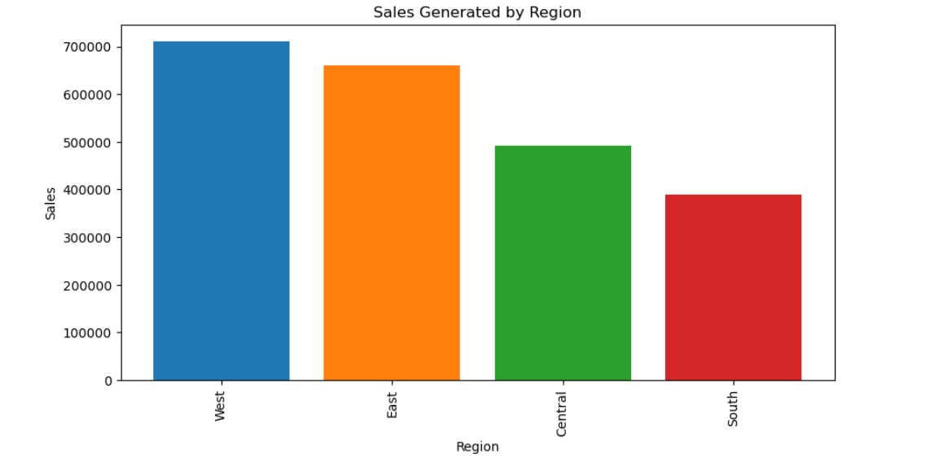

Slide 14
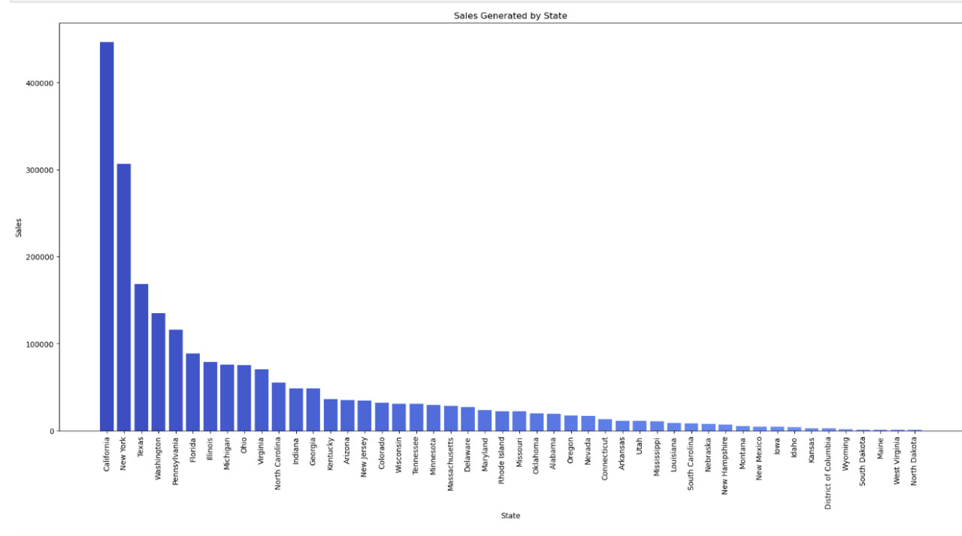
5.which state generate the most sales
Claifornia
new york
texas

Slide 15

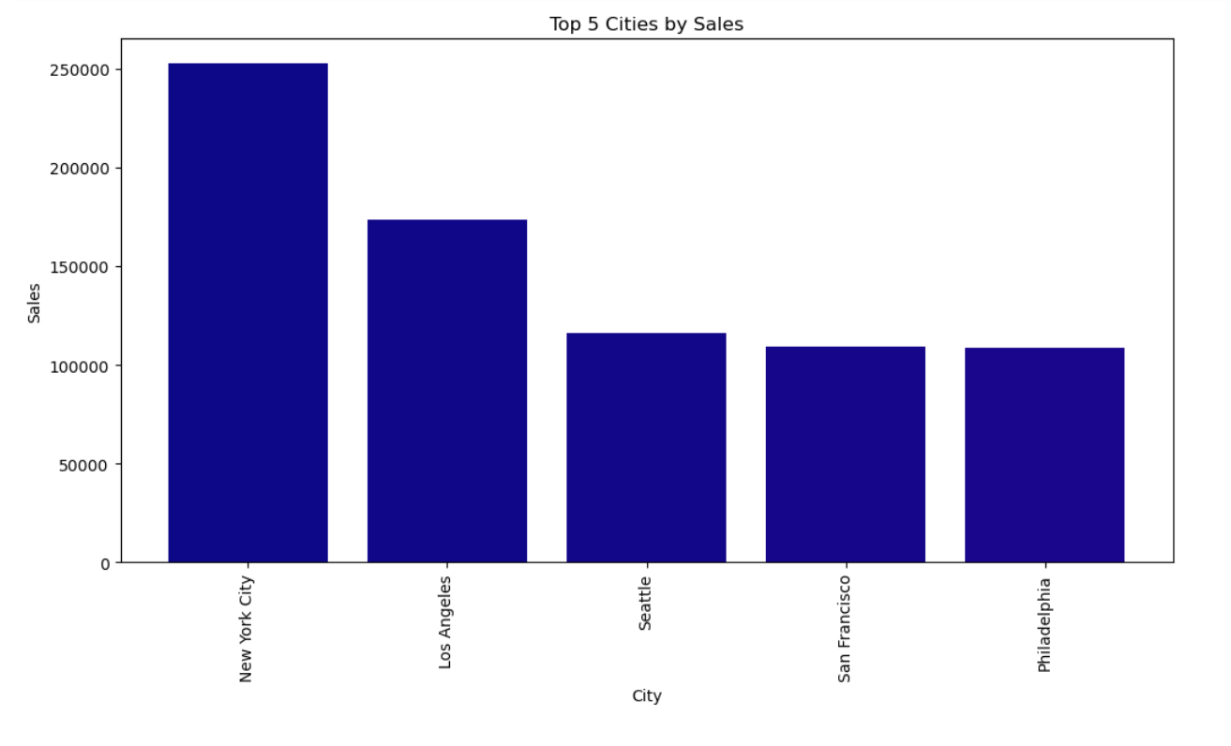
Top 5
Cities
by Sales

Slide 16
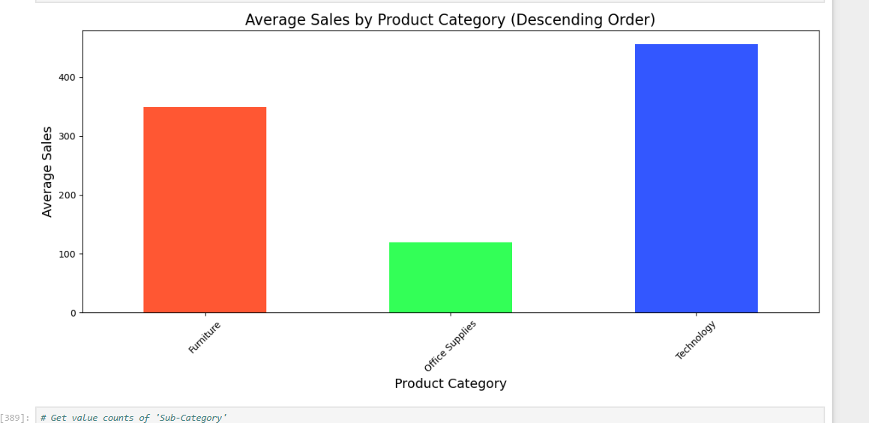
Average Sales by Product Category

Slide 17
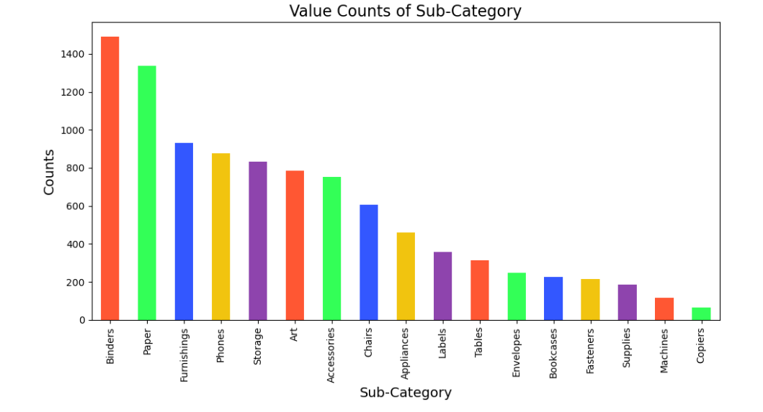
Count of Sales by Sub Product Category

Slide 18
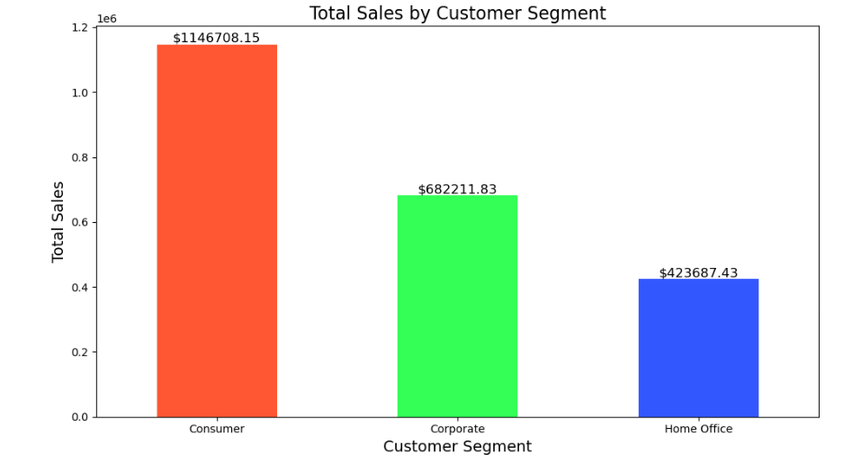
Total Sales by Customer Segemt

Slide 19
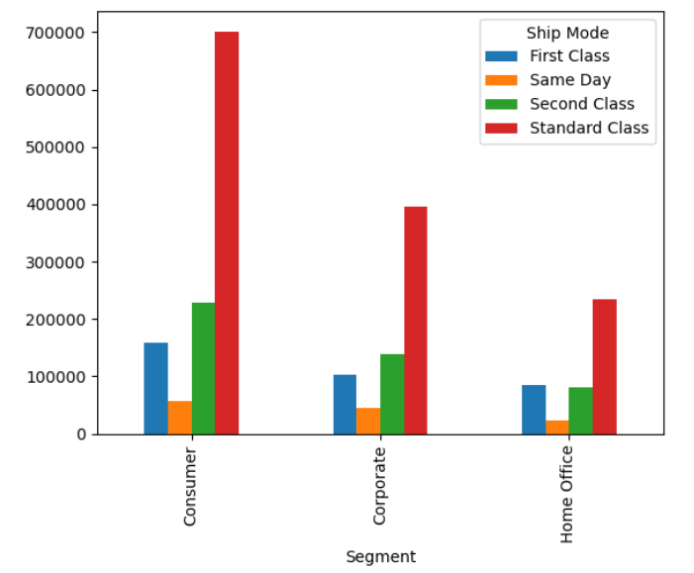
Which segment generates the highest sales across different shipping modes?

Slide 20
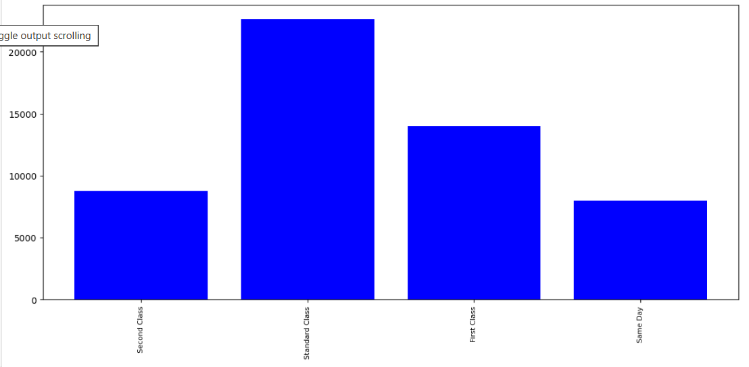
What shipping mode sold the most products ?

Slide 21
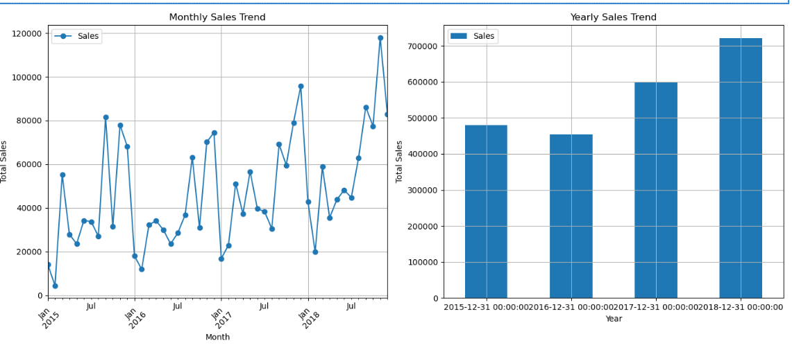
12. What is the Sales Trend over time ?

Slide 22
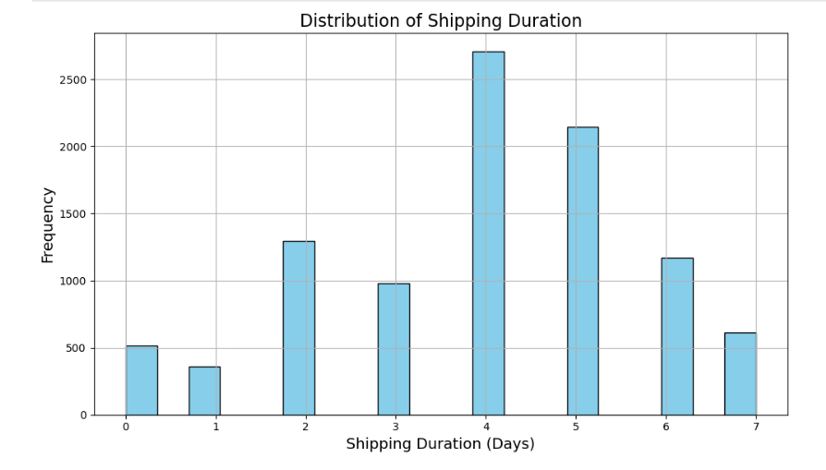
13.what is the distribution of Shipping Duration

Slide 23
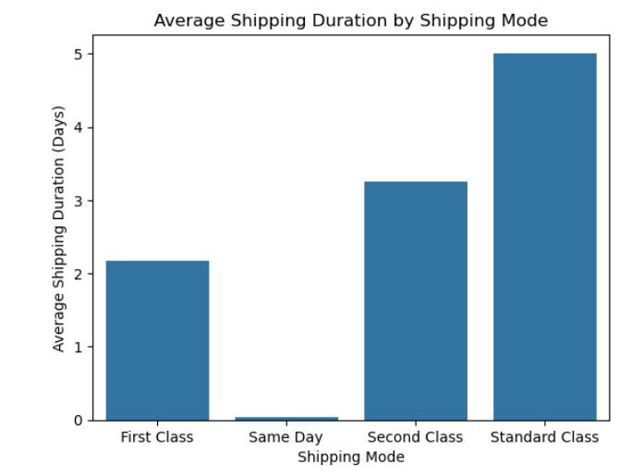
Average shipping duration by shipping Mode

Slide 24
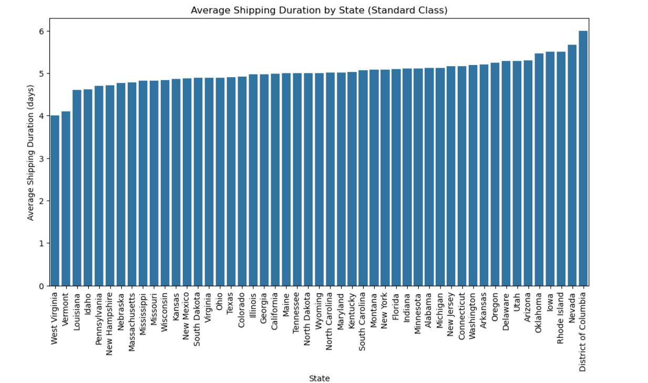
17.what is the Average shipping duration by state ?

Slide 25
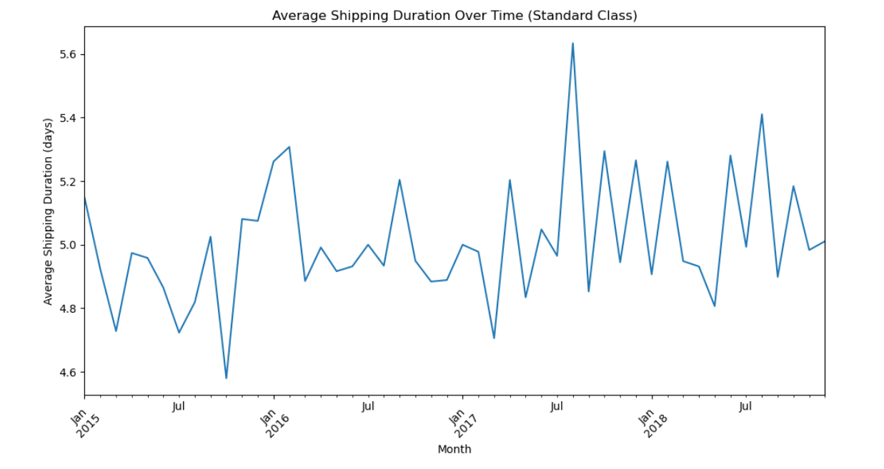
18.What is the Averge shipping Duration Over Time (Standard Class) ?

Slide 26
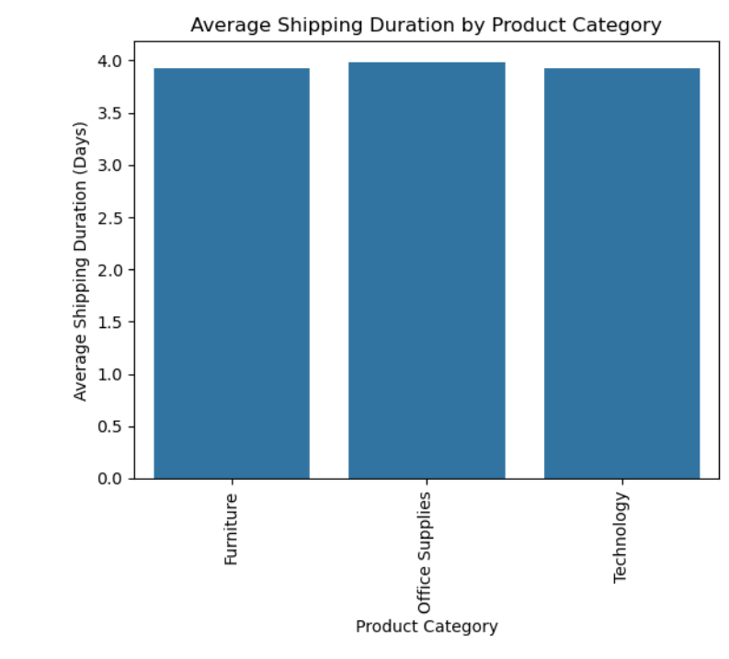
Average Shipping Duratoin by Product Category

Slide 27
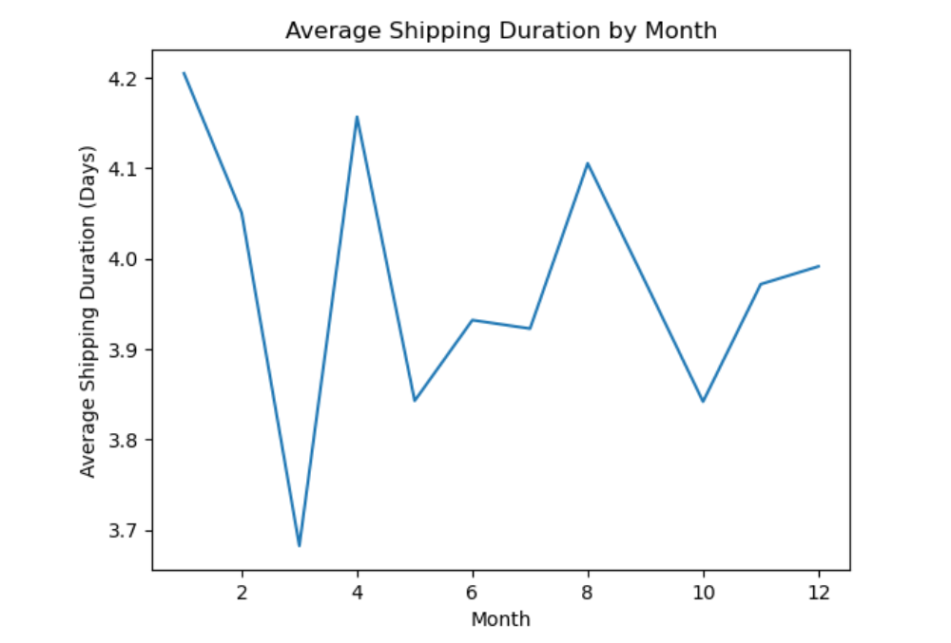
Average Shipping Duration by Month

Slide 28

Insights

Slide 29
1
Focus marketing efforts on the top selling products1 ensure stock availability, and consider analyzing customer segments purchasing this product to target them more effectively.
2
Allocate a larger portion of your marketing budget and resources toward the West, Central, California, and New York regions to further capitalize on these high-performing areas.
3
Focus marketing efforts on the top selling products1 ensure stock availability, and consider analyzing customer segments purchasing this product to target them more effectively.

Slide 30
4
Technology products drive the highest average sales, followed by office supplies and furniture. Within subcategories, binders and paper lead sales, surpassing furnishings. This suggests a strong demand for technology and essential office supplies, indicating that these categories should be prioritized in inventory and marketing strategies to maximize revenue.
5
Consumer is the largest sales segment, followed by Corporate and Home Office.
Standard Class shipping dominates across all segments, with First Class and Same Day services being less used. This suggests that focusing on standard shipping options for consumers, particularly for large-volume purchases, could optimize operations and meet the most common customer preferences.
6
The sales over months and years increase but there was a specific time in months that make sales decrease, this because
of many reasons, shipping duration , holidays , pricing and location of the customers also affect

Slide 31

build
model

Slide 32

1. Import Necessary Libraries
2. Correlation Analysis
Steps
3. Preprocessing Pipeline
4. Model Selection and Training
5. Hyperparameter Tuning with Grid Search
6. Data Splitting and Model Evaluation
7. Save the model
8.Test the model
Random Forest Regressor model has an accuracy of 61%, while the Linear Regression model has an accuracy of 59.63%

Slide 33

Hint
i got this low accuracy because there is a problem of the data,
i found later that it was incomplete , there was some columns missing , and these columns have a strong correlation with the my target , and the other columns in the data have a weak correlation with my target , that’t why i got low accuracy , at the first i have used a simple linear regression model and i got accuracy 1 % but then i have developed in the code until i got accuracy 61 %
Analysis And Sales Forecasting

Slide 34

Thank you

